Slide 1
Regression in Business
Regularisation in Regression
Varun Raste

Slide 2
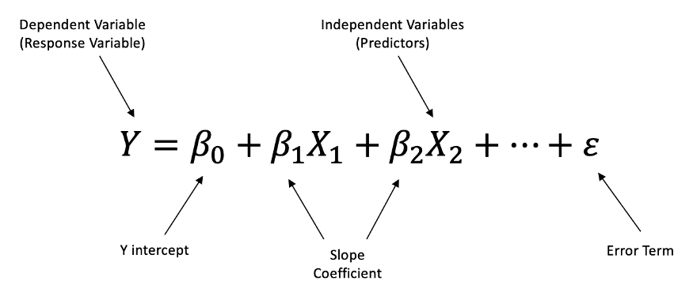
Assumptions of Multiple Regression
Linearity:
The relationship between independent variables and the dependent variable should be linear in nature.
Independence of Errors:
Residuals (errors) should be independent of each other — no autocorrelation should exist.
Homoscedasticity:
The variance of residuals should remain constant across all levels of the independent variables.
No Multicollinearity:
Independent variables should not be highly correlated with each other to ensure reliable coefficient estimates.
Normality of Residuals:
Residuals should follow a normal distribution for valid hypothesis testing and confidence intervals.

Slide 3
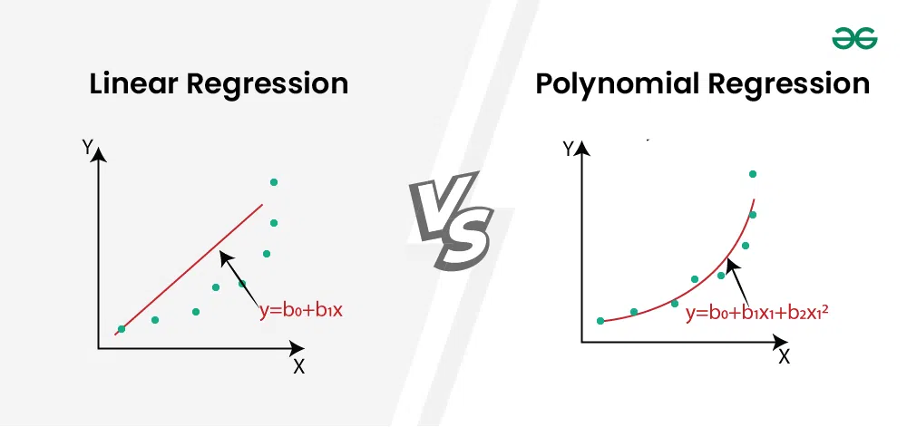
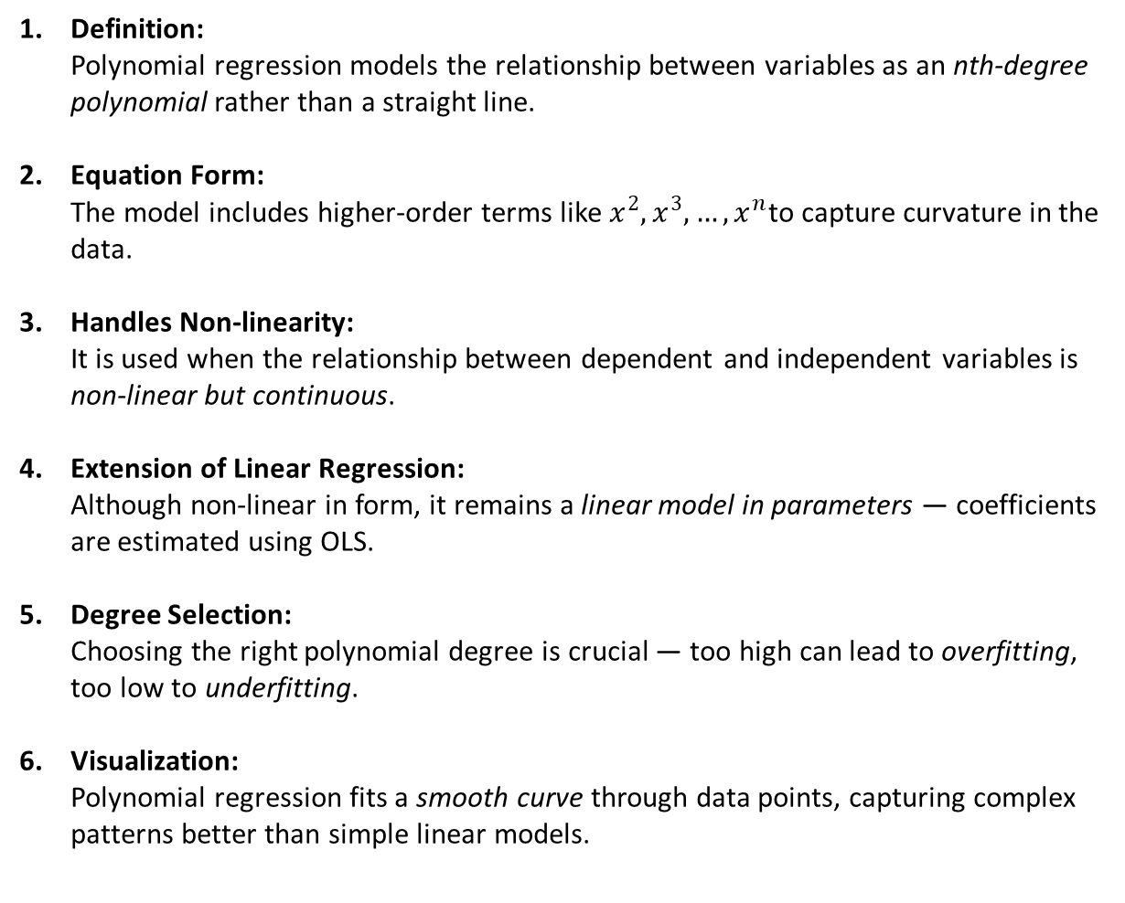
What is Polynomial Regression
Definition:
Polynomial regression models the relationship between variables as an nth-degree polynomial rather than a straight line.
Equation Form:
The model includes higher-order terms like $x^{2},x^{3},…,x^{n}$to capture curvature in the data.
Handles Non-linearity:
It is used when the relationship between dependent and independent variables is non-linear but continuous.
Extension of Linear Regression:
Although non-linear in form, it remains a linear model in parameters — coefficients are estimated using OLS.
Degree Selection:
Choosing the right polynomial degree is crucial — too high can lead to overfitting, too low to underfitting.
Visualization:
Polynomial regression fits a smooth curve through data points, capturing complex patterns better than simple linear models.

Slide 4
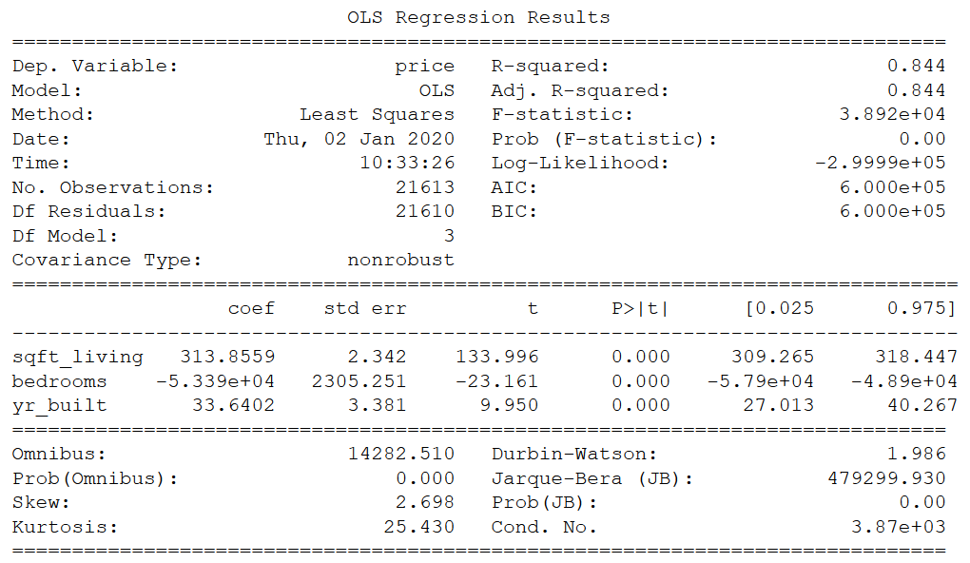
Reading Statsmodels

Slide 5
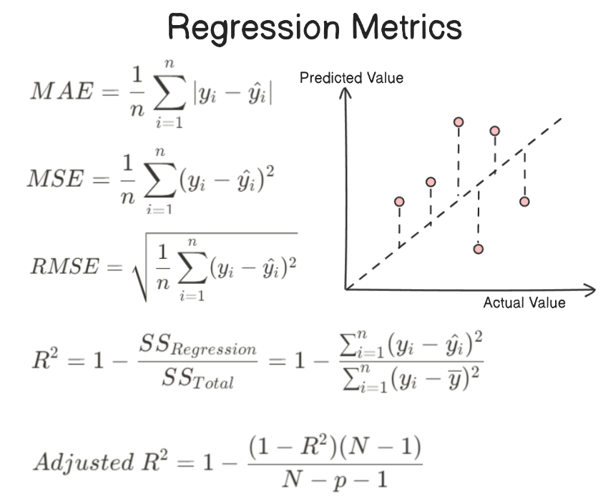
Metrics in Regression
R-squared (Coefficient of Determination):
Indicates how much variance in the dependent variable is explained by the model. Higher values imply better fit.
Adjusted R-squared:
Refines R² by penalizing the addition of unnecessary predictors — helps in model comparison.
Mean Absolute Error (MAE):
Represents the average magnitude of errors without considering their direction — easy to interpret in business terms.
Mean Squared Error (MSE):
Squares the errors to penalize larger deviations — useful for emphasizing big prediction mistakes.
Root Mean Squared Error (RMSE):
Square root of MSE, giving error in the same units as the target variable — widely used for model performance comparison.
Mean Absolute Percentage Error (MAPE):
Expresses prediction accuracy as a percentage — intuitive for business reporting and forecasting.

Slide 6
Model Strength (R² and Adj. R²):
R² = 0.844 → The model explains 84.4% of price variability, indicating a strong fit.
Adjusted R² = 0.844 → Confirms predictors add meaningful explanatory power without overfitting.
2. Overall Model Significance:
F-statistic = 3.89×10⁴, Prob(F) = 0.00 → The overall model is statistically significant.
Indicates that at least one independent variable has a significant effect on price.
3. Coefficients & Significance (P-values):
All predictors (sqft_living, bedrooms, yr_built) have p < 0.05, making them statistically significant.
The sign of coefficients shows direction of impact; e.g., sqft_living (+) vs bedrooms (–).
4. Diagnostic Checks:
Jarque-Bera (JB) = 479,299, Prob(JB) = 0.00: Residuals not perfectly normal — transformation may improve results.
Condition No. = 3.87e³: Indicates some multicollinearity among predictors, but not severe.
Prob(Omnibus) = 0.000 → Residuals deviate from normal distribution — normality assumption may be violated.
Skew = 2.698 → Positive skew, meaning residuals have a long right tail — model tends to underpredict for some higher values.
Kurtosis = 25.43 → Extremely high; suggests presence of outliers or a few extreme errors — may affect inference validity.
DW = 1.986 → Value near 2 indicates residuals are independent — good sign for regression assumptions.
Cond. No. = 3.87e+03 → Indicates moderate to high multicollinearity; advisable to check VIF (Variance Inflation Factor) values.
5. Business Implications:
The model accurately predicts prices, primarily driven by living area and year built.
Negative coefficient for bedrooms could signal space-efficiency or multicollinearity effects.
Recommend checking VIF scores and residual plots before deployment.

Slide 7
Regularisation in Regression
What is Regularization?
A technique that adds a penalty to the regression coefficients to prevent overfitting and improve generalization.
Why It’s Needed:
High-dimensional data or correlated predictors can lead to unstable, overly complex models.
L1 Regularization (Lasso):
Adds absolute penalty on coefficients; can shrink some coefficients to zero, enabling feature selection.
L2 Regularization (Ridge):
Adds squared penalty on coefficients; stabilizes model by reducing coefficient magnitude without eliminating features.
Elastic Net:
Combines L1 and L2 penalties to balance shrinkage and feature selection, useful when predictors are correlated.
Business Impact:
Produces simpler, more stable models that avoid overfitting and perform better on unseen data.

Slide 8
Cost Function
It measures how far the model’s predictions are from the actual values — essentially a “score of error.”
Why It Matters:
The regression algorithm learns by minimizing this cost, improving prediction accuracy step by step.
How It Works:
The model checks the difference between predicted and true values, and adjusts the coefficients to reduce this difference.
Sensitivity to Large Errors:
Most cost functions heavily punish bigger mistakes, ensuring the model pays more attention to outliers or bad predictions.
Role in Optimization:
Algorithms like Gradient Descent use the cost function as a guide to determine the best direction to update parameters.
With Regularization:
Cost functions also include penalty terms (Ridge or Lasso) that keep the model simpler and prevent overfitting by controlling coefficient sizes.

Slide 9
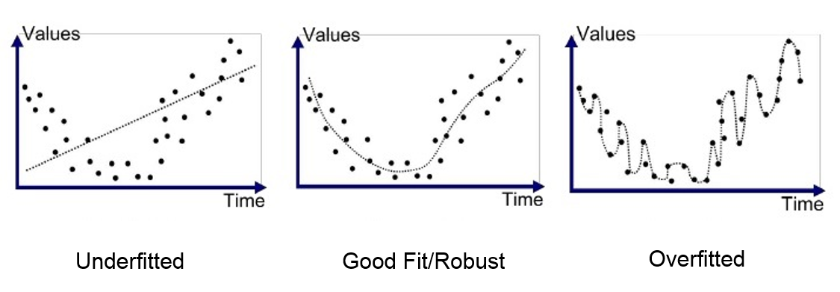
Concept of Underfitting / Overfitting
Overfitting:
Model learns noise instead of true patterns, performs great on training data but poorly on new data.
2. Underfitting:
Model is too simple and fails to capture underlying relationships, giving bad performance everywhere.
3. Key Difference:
Overfitting = too complex, memorizes; Underfitting = too simple, misses patterns.

Slide 10
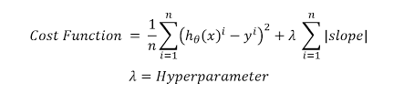
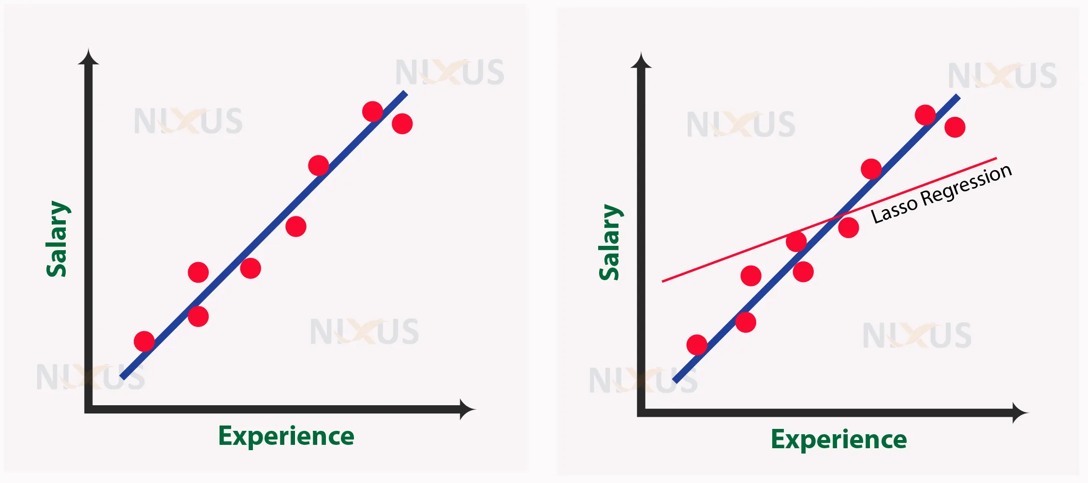
Lasso Regression
A regression technique that adds an L1 penalty to shrink coefficients and perform automatic feature selection.
Key Idea:
Minimizes the loss function while forcing some coefficients to become exactly zero, simplifying the model.
Why It's Useful:
Effective when you have many predictors, noisy data, or when you want a sparse, interpretable model.
Geometric Insight:
L1 penalty creates a diamond-shaped constraint, causing the error ellipse to touch the corners → coefficients drop to zero.
Business Impact:
Reduces complexity, improves generalization, and highlights the most influential drivers of the outcome.

Slide 11

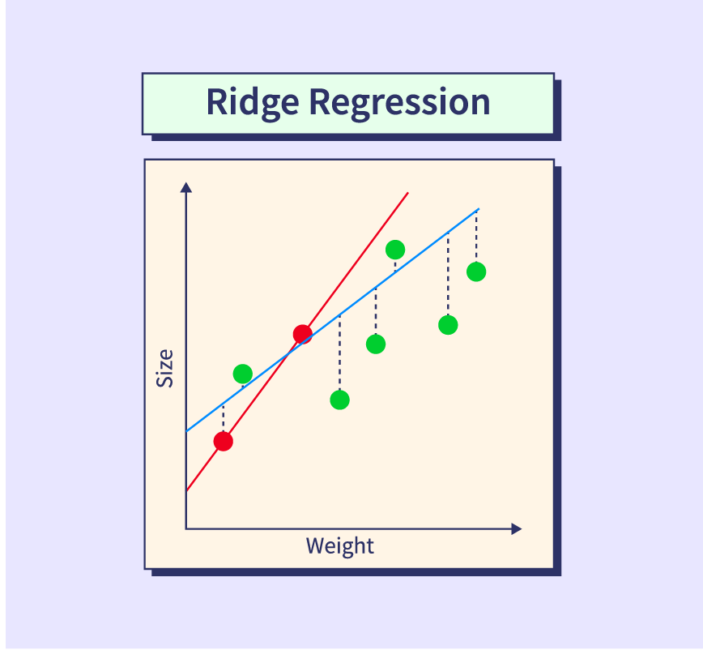
Ridge Regression
A regularized linear regression that adds an L2 penalty to prevent overfitting and stabilize coefficients.
Key Idea:
Penalizes the squared magnitude of coefficients, shrinking them toward zero without eliminating them.
When to Use Ridge:
Works well when predictors are highly correlated or when all features are expected to have some effect.
Effect on Coefficients:
Reduces coefficient variance, but no coefficient becomes exactly zero (unlike Lasso).
Business Impact:
Produces more stable and generalizable models, especially with noisy, multicollinear data.

Slide 12
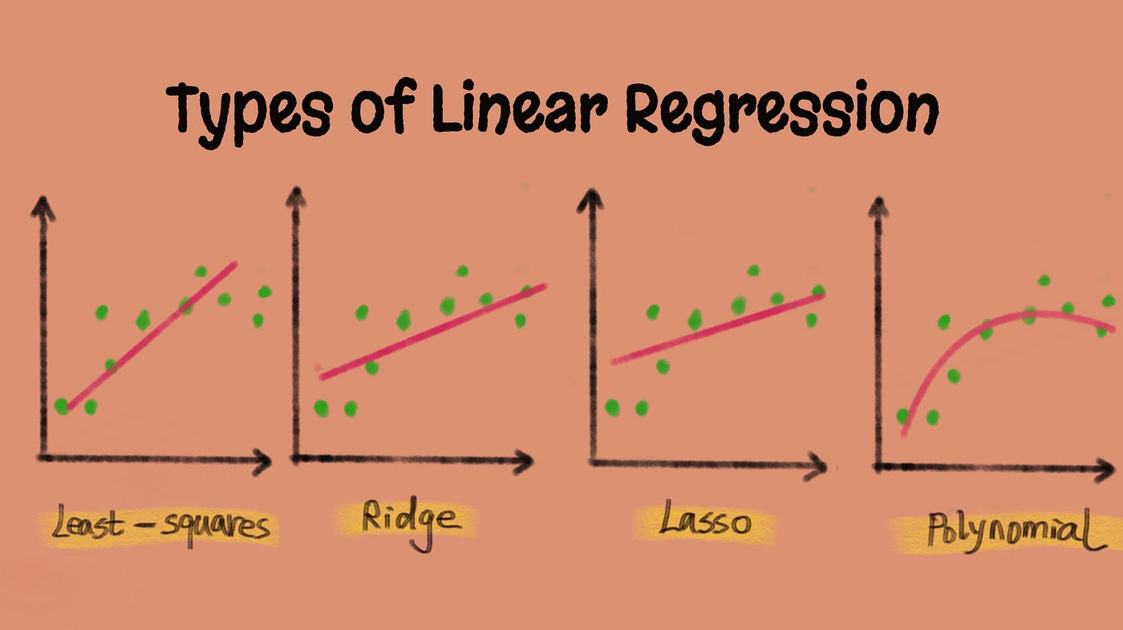

Slide 13
Ridge vs Lasso
Feature | Ridge Regression (L2) | Lasso Regression (L1)
Penalty Type | Sum of squared coefficients | Sum of absolute coefficients
Effect on Coefficients | Shrinks coefficients but never makes them zero | Shrinks and can set coefficients exactly to zero
Feature Selection | No | Yes (built-in feature selection)
Use Case | When most predictors are useful; multicollinearity | When you want a sparse model or many useless predictors
Stability | More stable when predictors are correlated | Less stable with high correlation
Geometry | Circular constraint (smooth) | Diamond constraint (sharp corners)
Interpretability | Moderate | High (because of sparsity)
Best For | Preventing overfitting; correlated features | Identifying key drivers; reducing model complexity

